Slide 1


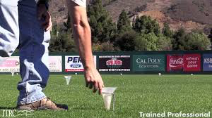
2015 Drought Response
Cal Poly State University
San Luis Obispo
Water Management and Drought Response
April, 2015
Dennis K. Elliot, PE, CEM
Associate Director, Energy, Utilities, and Sustainability

Slide 2

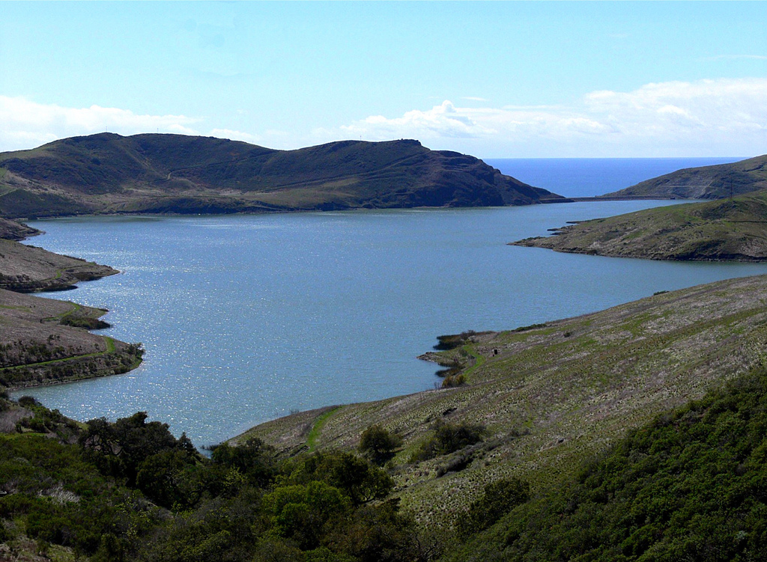
2015 Drought Response
Where does Cal Poly get its water?
Water Rights
Old Creek (fills Whale Rock Reservoir)
Brizziolara Creek (on campus)
Managed by Facilities and Ag Ops
Permit vs. License
Water Sources
Whale Rock Reservoir – Cal Poly, SLO, CMC
Wells and Springs
  Riparian vs. Groundwater
Reclaim Water?
  CMC Wastewater Plant to Chorro Creek Ranch
  Partner with SLO – Proposed Santa Rosa Park Plant
Need for a secondary source of supply

Slide 3

Wells, Springs, and Farm Irrigation

Slide 4

2015 Drought Response
How does Cal Poly Use water?
Whale Rock use - average 1,100 AF/year
Maximum safe yield estimated at 1,386 AF/year
(This could be affected by climate change)
Building Use – 25%
Landscape and Sports Complex – 33%
Ag Operations – 42%
Cal Poly Ag Water
CAFES is allocated a maximum 449 AF/year of the campus’ Whale Rock water by internal Cal Poly agreement
Sports Complex is also irrigated with “Ag water” which does not count against CAFES allocation
Riparian wells – 80 to 130 AF/year

Slide 5
2015 Drought Response
How is Cal Poly Conserving Water?
Low flow plumbing retrofits
  Toilets, urinals, shower heads, faucet aerators
Landscape Irrigation Management
  Use of drought tolerant and native plant species
  Wireless ET irrigation control system
  Turf reductions – 14.5% since 2007
Farm Operations
  Micro emitters on orchards
  Upgraded sprinklers on pastures and row crops
  Improved management of wells and storage reservoirs
  Variable frequency drives on main well pumps
CSU Sustainability Best Practice Awards
  Water Conservation and Site Water Quality
  2007, 2012, and 2015

Slide 6
2015 Drought Response
What is Cal Poly’s Guiding Philosophy for Water Use?
Maximize beneficial use <or> maximize conservation?
“Cal Poly should exhibit leadership to the State of California by striving to use the least water possible within the constraints of funding, technology, and programmatic needs.”
  Drought Planning Group
  Sustainability Advisory Committee
  Master Plan Natural Resources and Sustainability Committee
  Executive Director of Facilities
  VP for Administration and Finance
  President’s Office and Council of Divisional Vice Presidents
Great opportunities for Campus as Living Lab, Learn by Doing
What could be done if we had “excess” water?
  Ground water recharge
  Riparian habitat restoration
  Help serve communities in water supply crisis – revenue?

Slide 7
2015 Drought Response
2014 Governor Declares Statewide Water Emergency
Reduce “personal” use 10% by 2016, 20% by 2020
CSU Board adopted as part of 2014 Sustainability Policy
Drought Planning Group convened
Immediate measures implemented in all areas
$305K in water conservation project funding approved by CO
2015 Governor Issues Exec Order B-29-15
Reduce “potable” water use 25% by February 2016
2014 Plan updated to be more aggressive
28% reduction in turf proposed (see map)
Cal Poly is applying these reductions to all water use

Slide 8
2015 Drought Response
How is Cal Poly Conserving Water?
Low flow plumbing retrofits
  Toilets, urinals, shower heads, faucet aerators
Landscape Irrigation Management
  Use of drought tolerant and native plant species
  Wireless ET irrigation control system
  Turf reductions
Farm Operations
  Micro emitters on orchards
  Upgraded sprinklers on pastures and row crops
  Improved management of wells and storage reservoirs
  Variable frequency drives on main well pumps
Educational Outreach
  PowerSave Campus – Polly the Polar Bear campaign
  Annual Red Brick Energy and Water Competition
  Paper and digital signage in Housing, ASI, Campus Dining

Slide 9
2015 Drought Response
How are we doing?
Water use has remained flat since early 2000’s, despite:
60% increase in building square footage
100% increase in on-campus housing
From 2013 to 2014, total water use was reduced by 23%
Projected savings from 2015 Irrigation and Plumbing retrofits – 3%
Reductions by type
2013 - 2014:
Landscape – 10%
Sports – 16%
Ag – 43%

Slide 10
2015 Drought Response
What do we still need to do?
Continue low flow plumbing retrofits
  State $375K, Housing $425K
Expand Wireless Irrigation Control System - $850K
Eliminate 13.6 acres (28%) of remaining turf - $30K plus replanting costs
Replace 8,000 ft of aging Ag water main - $1M
Close down campus wash rack
Cut power washing by 50%
Seek sources of reclaimed water
Increase publicity, outreach, signage

Slide 11
2015 Drought Response
How can the President’s Office be of support?
Provide additional funding for implementation
Communicate Sustainability values and specific goals in:
Cal Poly Strategic Plan
Cal Poly Master Plan
Advancement focus
Curriculum development
Vision 2022
The Mustang Way
Campus as Living Lab – Earn by Doing/Learn by Doing
Attend a meeting of each Sustainability Committee?
Host a Sustainability Summit?
Participate in marketing/outreach – Polly video?
Recognize accomplishments of faculty/staff/students – award?

