Slide 1


Sustainability Best Practices
Partnerships, Communications and Planning
Optimizing the Business Case for Carbon Neutrality and Climate Resilience
Presented to CHESC
July 7, 2020
Dennis K. Elliot, PE, CEM
Director - Energy, Utilities, and Sustainability
Cal Poly State University, San Luis Obispo

Slide 2

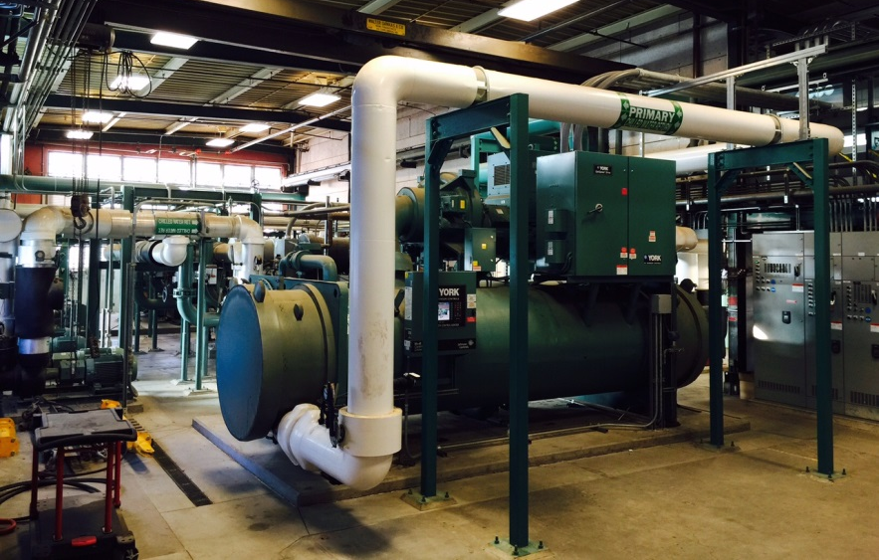
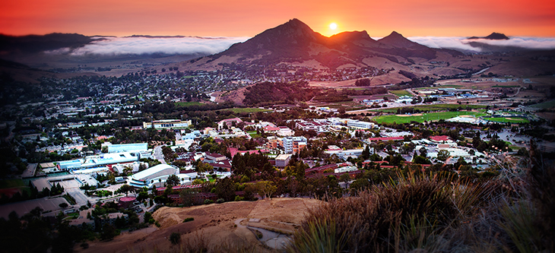
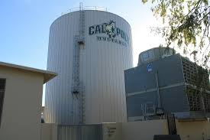
Cal Poly Campus Overview
Founded 1901
21,000 FTE
6.5M GSF
10,000 acres
4 central plants
1.6M gal TES
1.5M gal domestic water storage
Single 70 kV substation

Slide 3
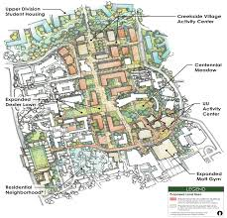
2035 Master Plan
2035 Master Plan Goals:
Enrollment increase to 25,000 (headcount)
1.3M GSF new Academic & Support Space
7,000 beds new student housing
380 units workforce housing
No increase in parking
Preserve prime ag land
Support new technologies
24/7 campus
Challenges:
2050 carbon neutrality goal
$350M DM backlog
PSPS
Aging infrastructure

Slide 4
Utility Master Plan Scope
First comprehensive Utility Master Plan to evaluate:
Electrical service from PG&E, HV substation and 12 kV distribution
Natural gas distribution
Potable water supply, distribution, storage, and firefighting capacity
Sanitary sewer
Storm sewer and 100-year flood risk
District heating and cooling
Telecommunications infrastructure
Building Automation and SCADA
Criteria:
Capacity, age, condition, reliability, redundancy
Efficiency, carbon emissions, climate resilience
Life cycle cost
Budget - $875K
Selected consultants – Affiliated Engineers (AEI), Cannon

Slide 5
Utility Master Plan Process
Success required LOTS of stakeholder engagement!

Slide 6
Utility Master Plan Findings
Heating/Cooling
Simultaneous heating/cooling = heat recovery chiller opportunity
Offsets gas use in boiler plant
Will need to reduce HWS temp from 180 down to 140-150 deg F
Will require addition of HW TES

Slide 7
Utility Master Plan Findings
Heating/Cooling
Central Plant reductions from BAU:
Carbon 31-66%
Water 46-69%
Uses EPA social cost of carbon
LCCA
Sensitivity analysis
Carbon sequestration vs. offsets?

Slide 8
Utility Master Plan Findings
Electrical
Peak electrical load to TRIPLE due to added space and electrification
Proposes 2nd substation fed from PG&E’s 115 kV transmission system
  Provides better supply resilience to PSPS
  Extends life of campus 12 kV duct bank and cabling
  Supports expansion of EV charging
  Uses batteries for:
    Peak shaving/TOU load shifting
    Non-export compliance and PV generation management
    Future microgrid

Slide 9
Utility Master Plan Findings
Water and Sewer
Identified aging clay and Transite and undersized pipe sections needing replacement
Surveyed sewer manhole rims & inverts, created hydraulic model to analyze flow and capacity
Camera inspection of sewer backbones and critical laterals - software identified and graded all deficiencies for prioritized repair
Metered dry/wet weather flows to quantify I&I
Found we need more firefighting storage
Found we need a bigger sewer jetter

Slide 10
CESA – Climate and Energy Scenario Analysis tool
Originally developed by EcoShift for UC Santa Cruz
Open source tool built in Excel – user configurable
Adapted original version for Cal Poly, worked with EcoShift to customize:
  Building level EUI
  Increased space types from original four to include all T24 building types
  Calibrated energy efficiency and new construction modules using actual CSU data
  New features/modules:
    Transportation strategies for Scope 3 emissions
    Impact of trades maintenance staffing levels using APPA guidelines
    Building level Facility Condition data from ISES reports
    Relationship to the DM backlog
Calculates NPV of capital, O&M, energy, carbon – total cost of ownership
Just beginning to run scenario analyses to optimize:
  Existing buildings - deep energy retrofit vs. renovate vs. demo & replace?
  New buildings – target EUI, exceedance of T24
  Investment in renewables/on-site generation
  Investment in TDM strategies
  Maintenance staffing levels

Slide 11
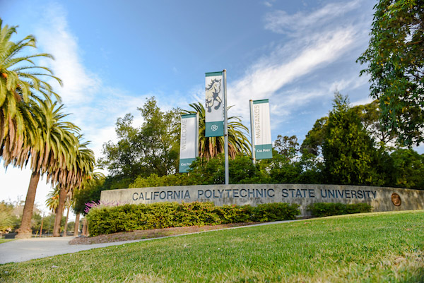
Sample Results
Full 2035 Master Plan buildout will require ~$550M in support infrastructure
For same cost as BAU, can reduce central plant carbon 31%, water 46%
For investment 15% above BAU, can reduce central plant carbon 66%, water 69%
May be able to justify acceleration of carbon neutrality goal

Slide 12
Lessons Learned
Update Utility Master Plan every time you update your Campus Master Plan
Involve all stakeholders (procurement, PD&C, trades, energy/sustainability):
  Development of scope and deliverables for RFQ/RFP
  Identification of necessary field investigation/inspection/testing
  Consultant interview and selection
  Initial project kickoff and regular progress meetings
  Data collection and field investigation
  Draft and final report review
  User training
Require consultant update existing utility system models or create new
Calibrate models with actual data
Try to create a living document that can adapt to how your Master Plan unfolds
Create flexible and campus user-configurable planning tools
Require planning tools be tested/commissioned
Make all cost factors and escalators adjustable
Perform sensitivity analysis
Update your utility atlas before you start, and again after report is complete

Slide 13

Thank You!
Questions?

