Slide 1


Sustainability Best Practices
HVAC Retrofit
Variable Flow CHW Pumping
and Plant Optimization
June 29, 2016
Dennis K. Elliot, PE, CEM
Director - Energy, Utilities, and Sustainability
Cal Poly State University, San Luis Obispo

Slide 2

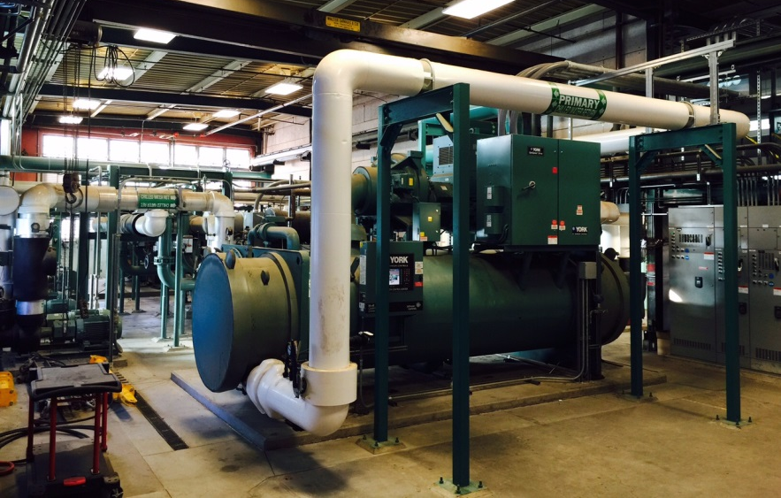
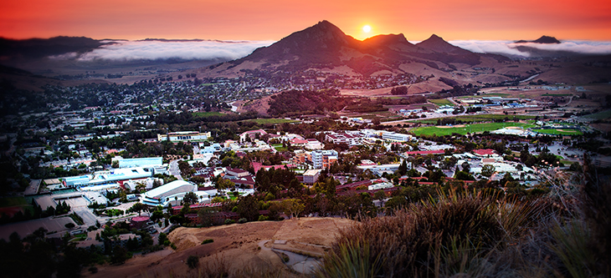
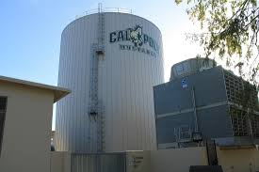
Cal Poly Central Chiller Plant
5 Chillers – 2,550 tons capacity
1.6M gal Thermal Energy Storage Tank
Serves 21 buildings, 1.1M GSF
Constructed 1997 for future TES
Expanded in 2004
Expanded in 2011, TES added

Slide 3

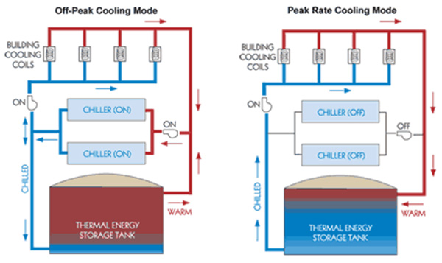
How Does TES Work?
On-peak (noon to 6 pm):
Pump from tank
Off-peak:
Charge tank
Load Shift ~ 1MW
Chillers run at night
Tank performance:
Water stratifies by temperature
Insulation losses < 1%/day
Total energy stored = mass x dT
Designed for 20 degree Delta T

Slide 4
Buildings Control the Plant Delta T!
CHWS
PUMP
DECOUPLER
AHU
AHU
CHWR
Building Tertiary Loop
Constant Volume

Slide 5
Retrofit to Boosted Secondary
VFD
CHWS
PUMP
AHU
dP
AHU
CHWR
Building Tertiary Loop
Variable Volume

Slide 6
Retrofit Project Scope
Goals:
Maximize building and thus Plant delta T
Reduce flow rates, minimize pumping energy
Optimize chiller and cooling tower operation
Scope:
Convert 14 buildings to “boosted secondary”
  Remove AHU bypasses and building decouplers
  Install VFD’s, pump bypasses, 2-way valves
  Implement “most open valve” control scheme
Implement optimization scheme in Chiller Plant
  Run both towers, variable CDW flow, minimize fan energy
  Stage chillers to ensure full charge before peak period

Slide 7
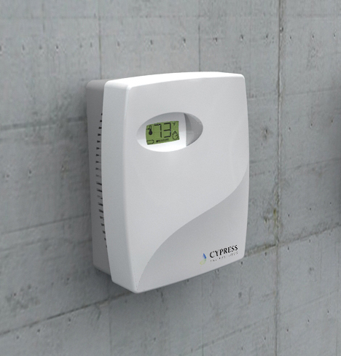
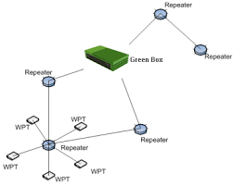
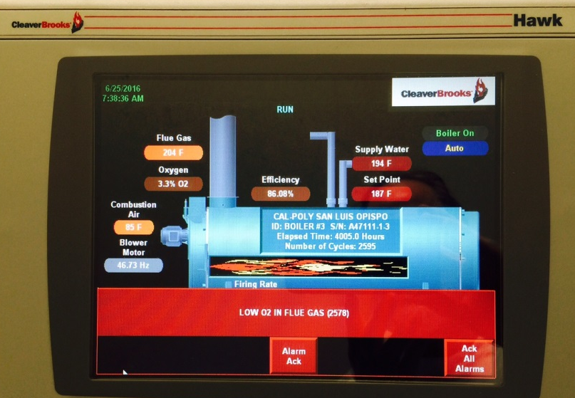
Retrofit Project Scope
Scope:
Install 204 Cypress wireless pneumatic stats in 3 buildings
  DDC system now sees zone temps via BACnet
  Allows more sophisticated supply temp reset
New combustion controls on Central Plant Boilers
  Digital O2 trim
  Combustion blower VFD’s

Slide 8

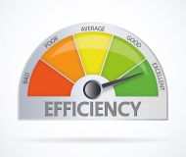
Project Results
Project cost: $1.4M, 11 year payback
Savings:
1,000,000 kWh/yr of electricity
47,000 therms of natural gas
610 tonnes C02
$128,000/yr utility savings
Improvements to plant performance:
Before: 13 degree Delta T, 0.75 kW/ton
After: 19 degree Delta T, 0.68 kW/ton
46% increase in TES energy storage

Slide 9
Sustainability Best Practices
Resources
Dennis Elliot – Director of Energy, Utilities, and Sustainability
(805) 756-2090
delliot@calpoly.edu
www.sustainability.calpoly.edu
Links:
PG&E On-Bill Finance
SCE On-Bill Finance
SDG&E On-Bill Finance
CEC Energy Efficiency Financing

Slide 10

Sustainability Best Practices
Questions?

