Slide 2
Student Sustainability Leadership Summit
Kylee Singh, Sustainability Coordinator
Ben Christensen, Green Campus Team Manager
Notes:
Welcome and Introductions

Slide 3
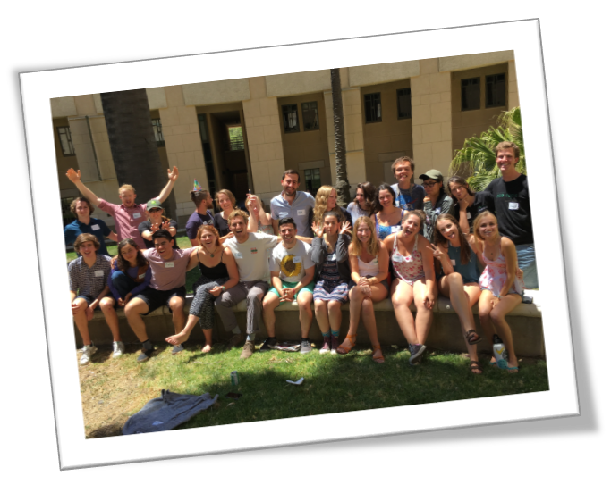
Overview
Purpose
Goals
Logistics
Structure and Agenda Setting
Outcomes
Next steps

Slide 4
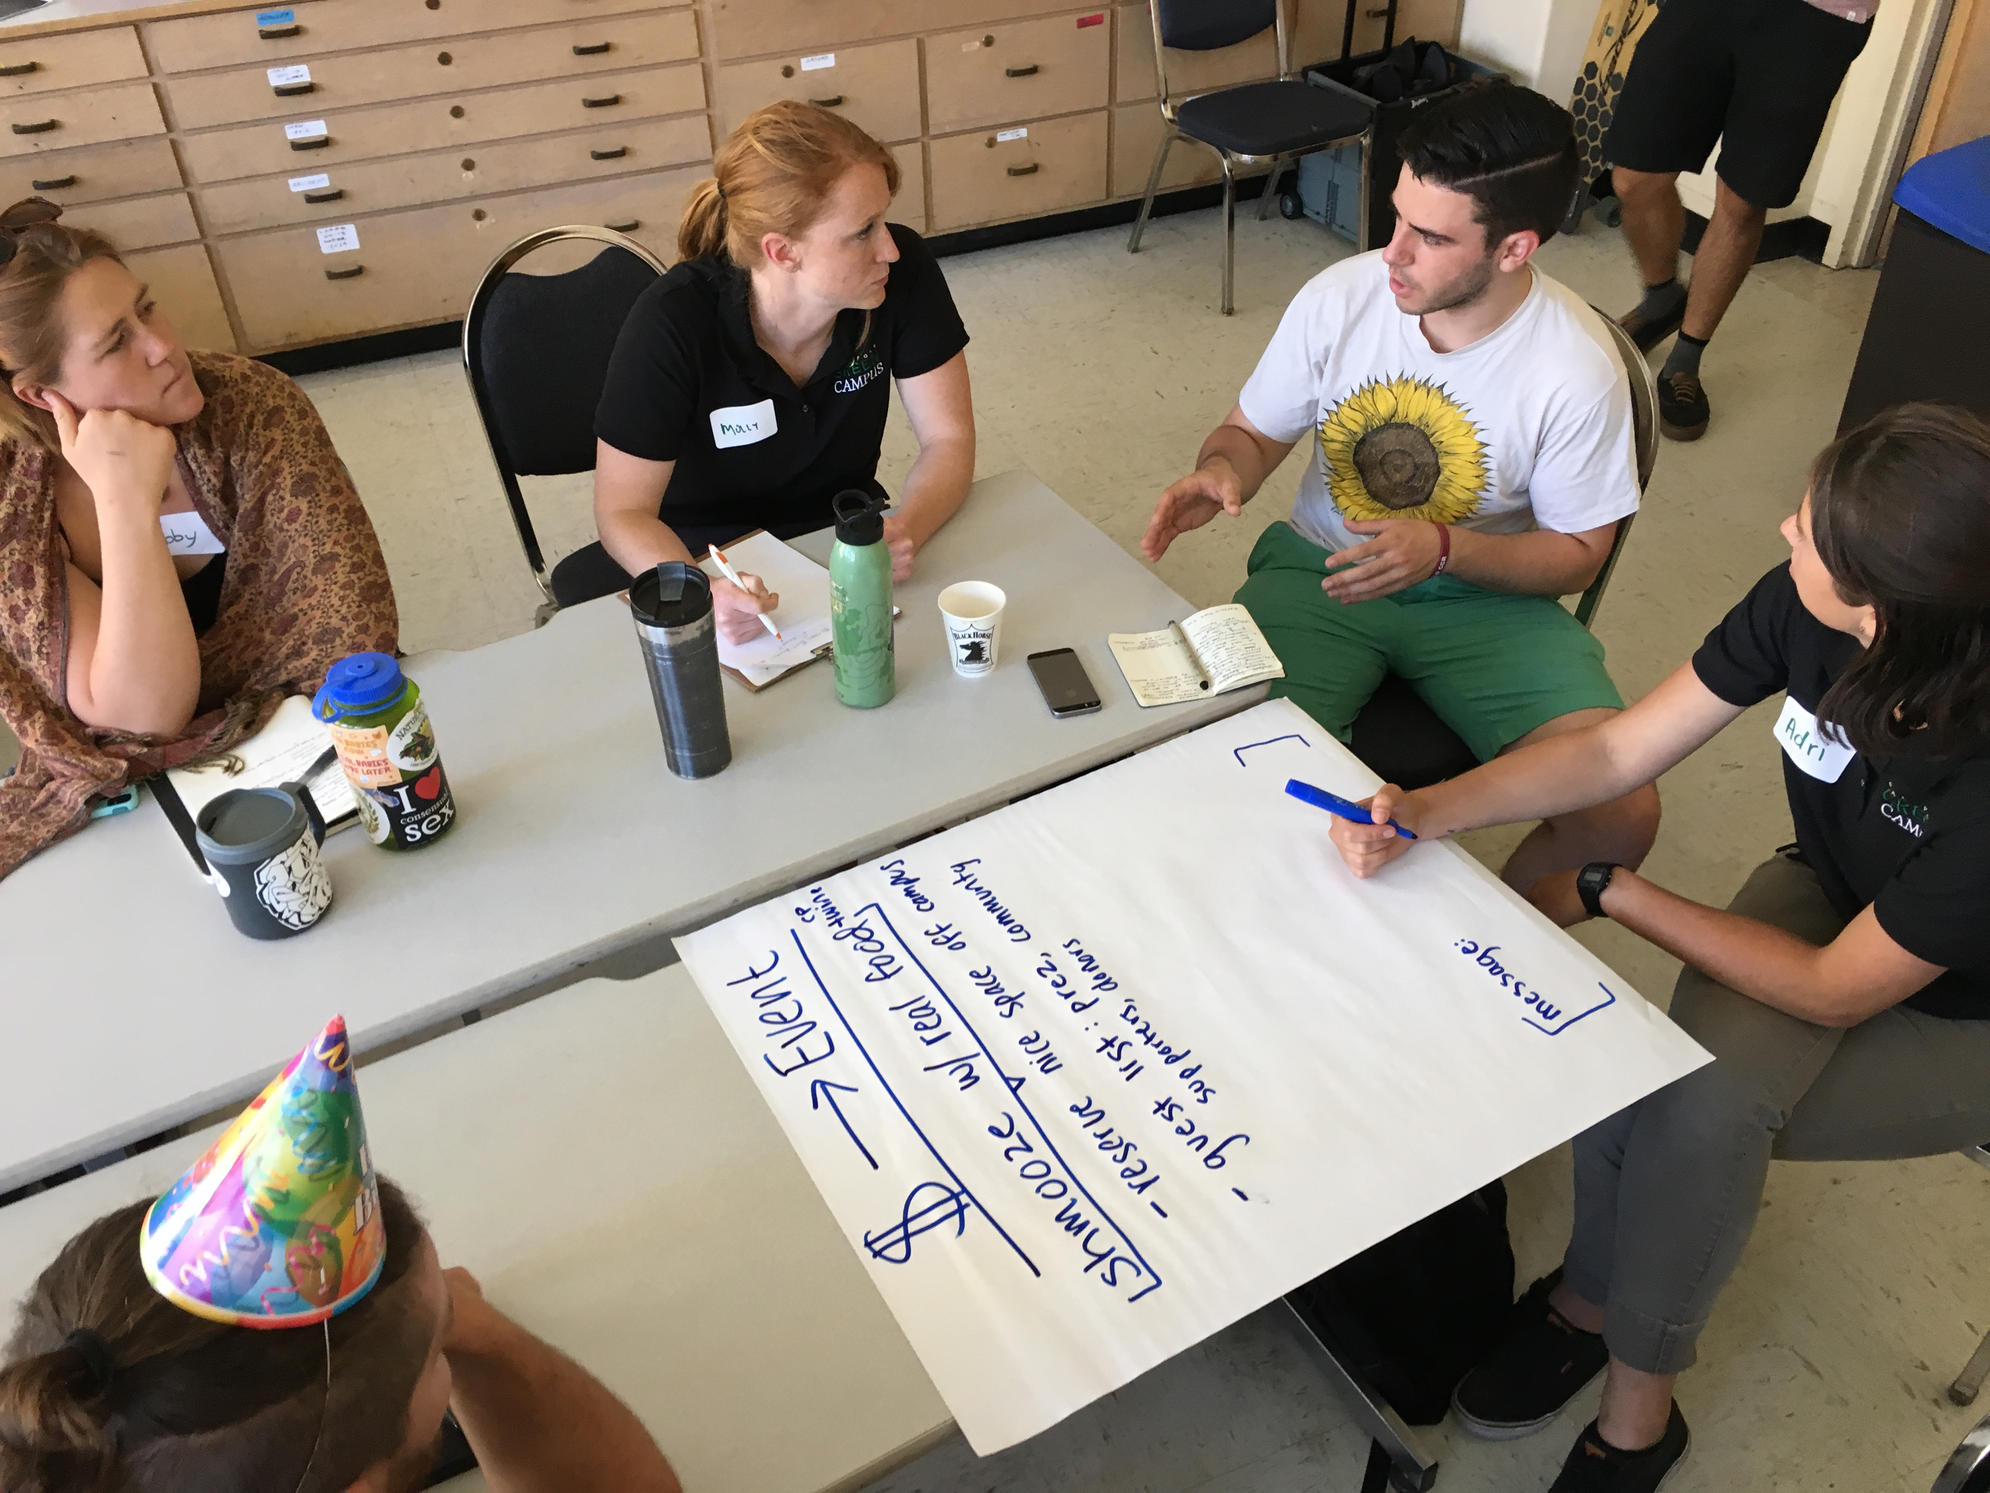
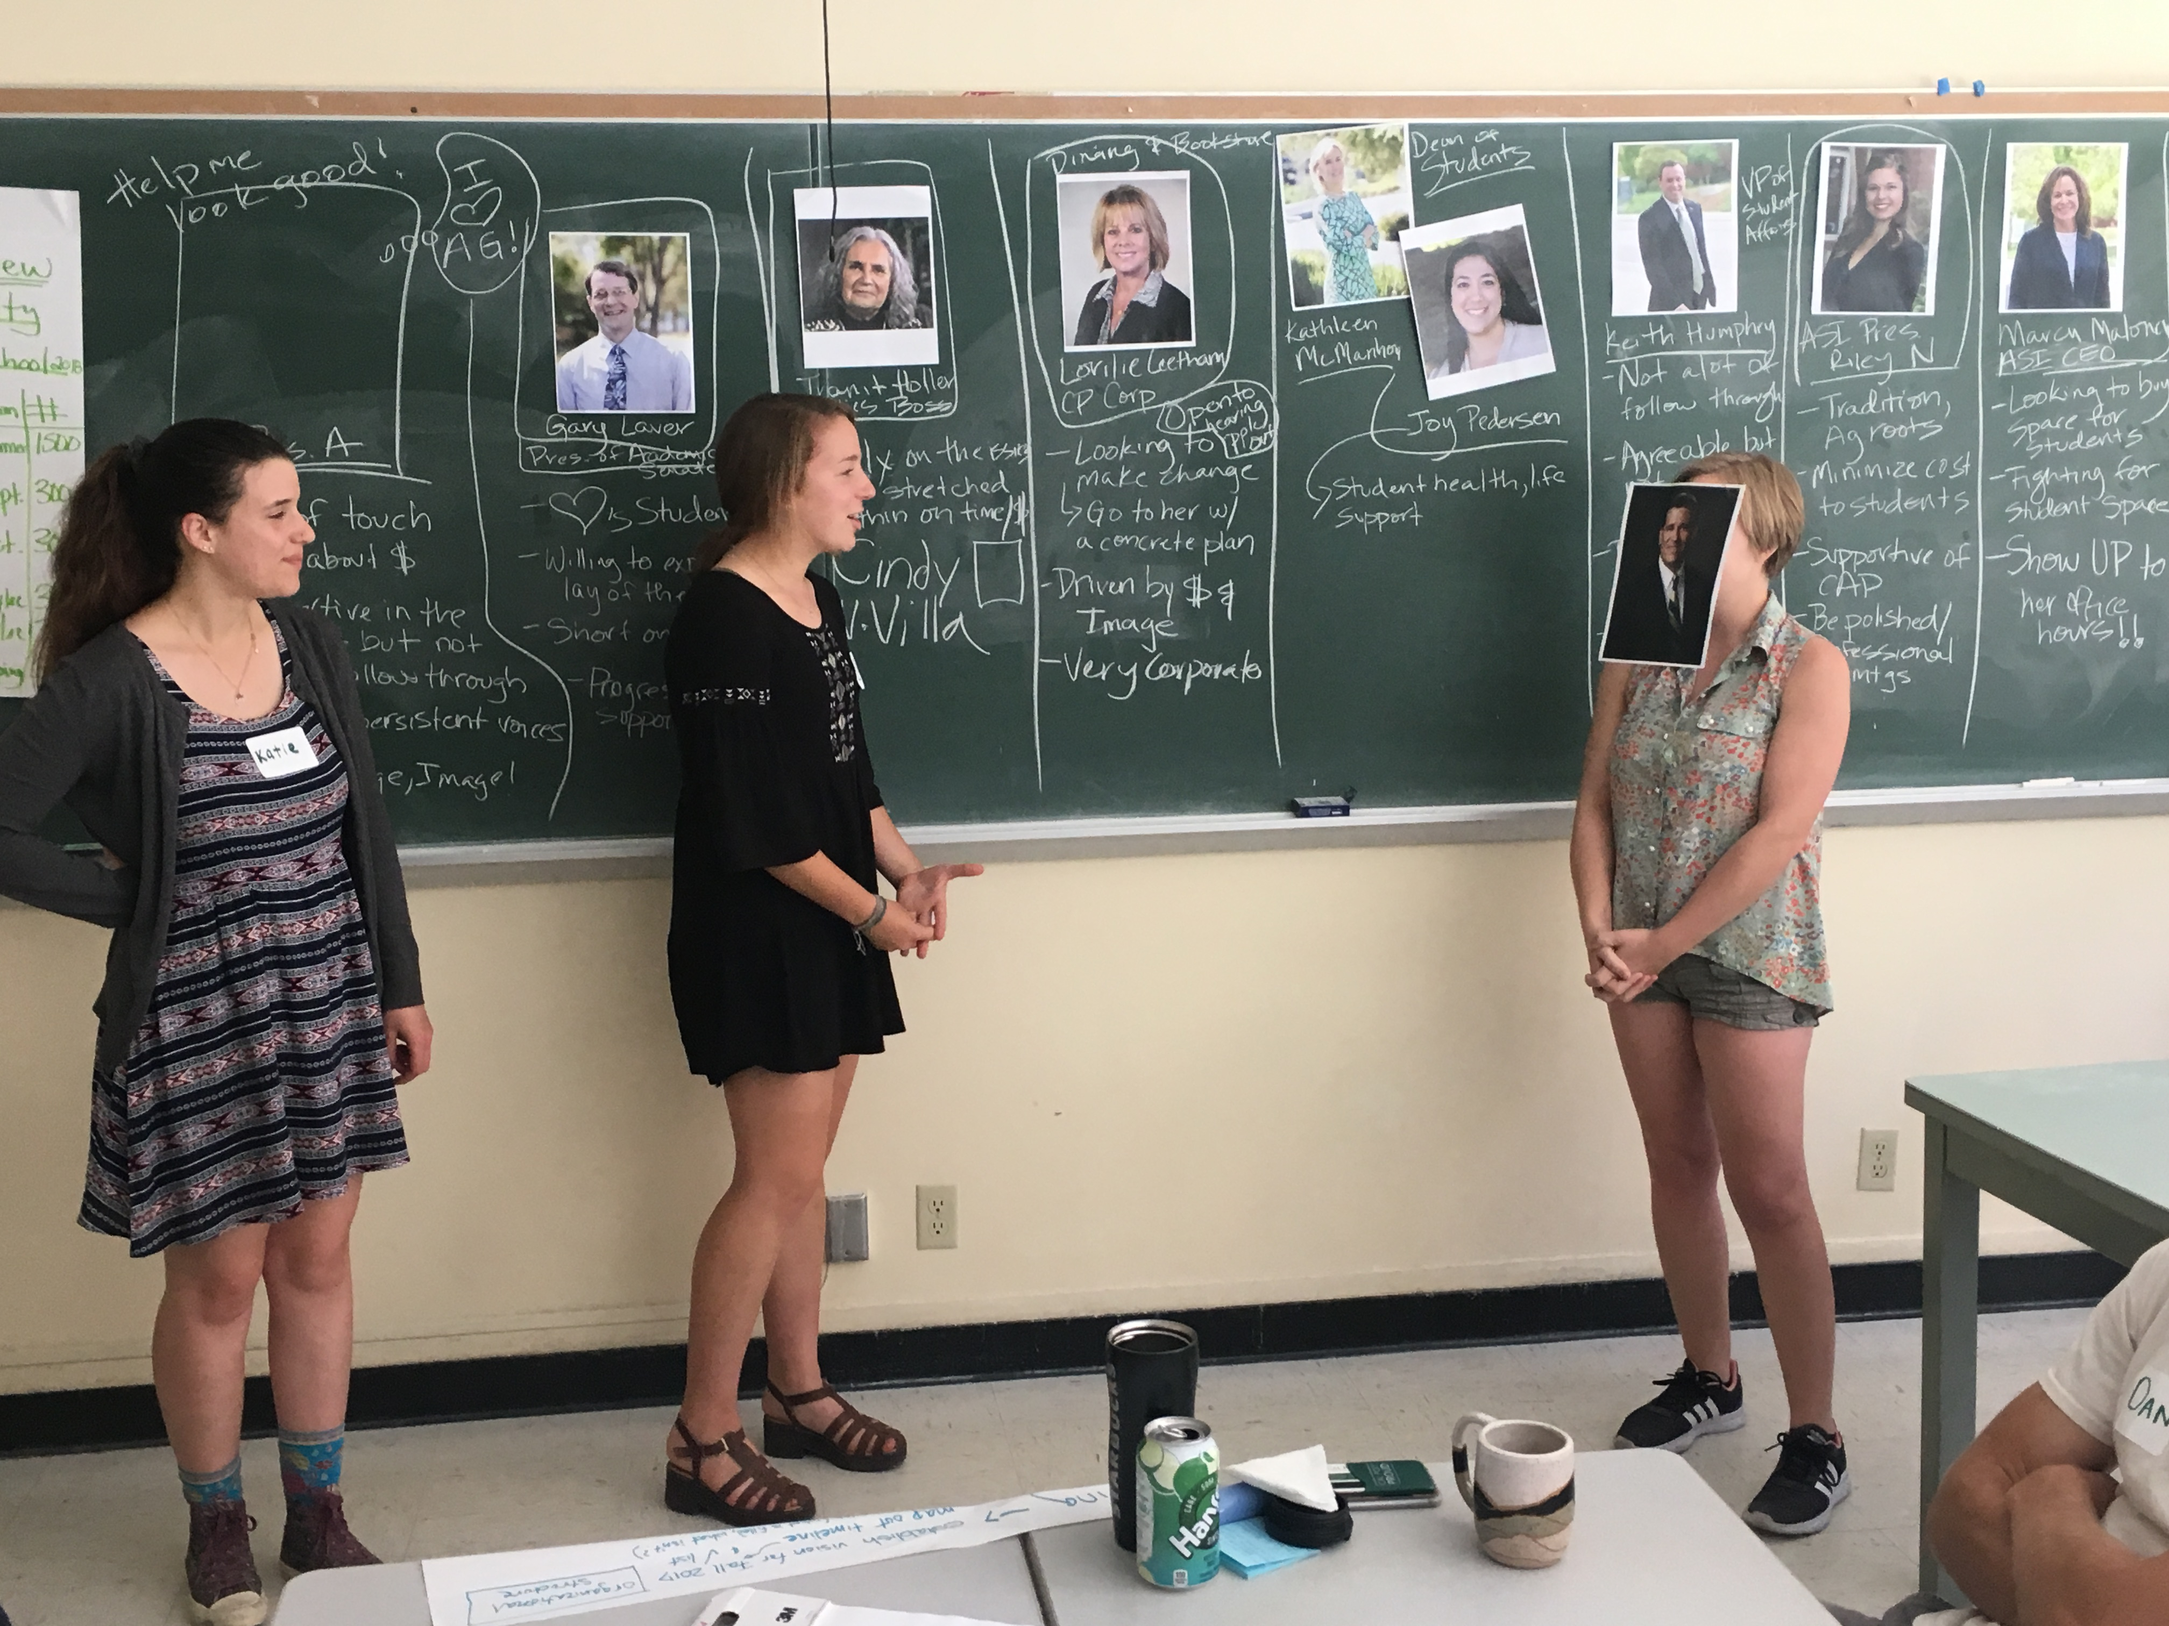
Purpose
1. Redundant/ inefficient efforts
2. Great ideas: poor implementation
3. Slow yearly start

Slide 5
Purpose
Redundant/ inefficient efforts
-Fault of lack of communication
-Redundant work and goals
-Need for sustainable community building

Slide 6
Purpose
Great Ideas: Poor Implementation
-Ideas are not feasible
-Lack of understanding of institutional support
–Leadership/implementation learning (something students need)

Slide 7
Purpose
Slow Yearly Start
-Efforts require a set up phase
-Miss energy and availability of students
-Sets back yearly timeline

Slide 8
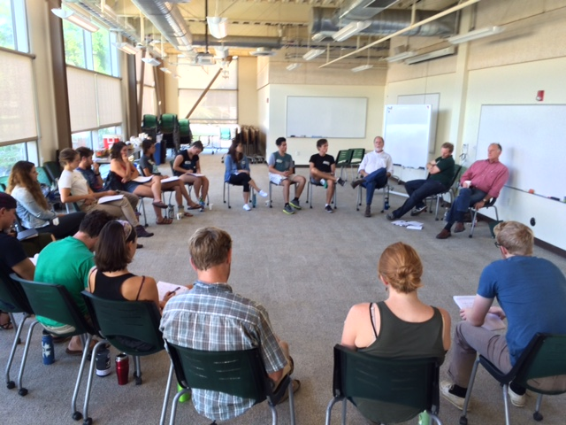
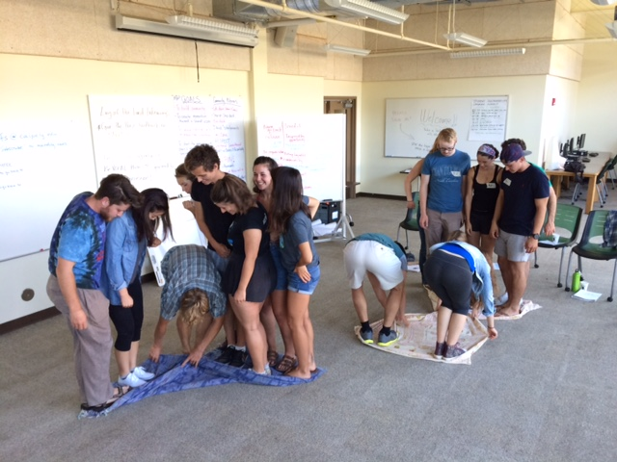
Goals
Build community
Draft work plans
Brainstorm partnerships
Develop a shared vision
Create a leadership training template

Slide 9
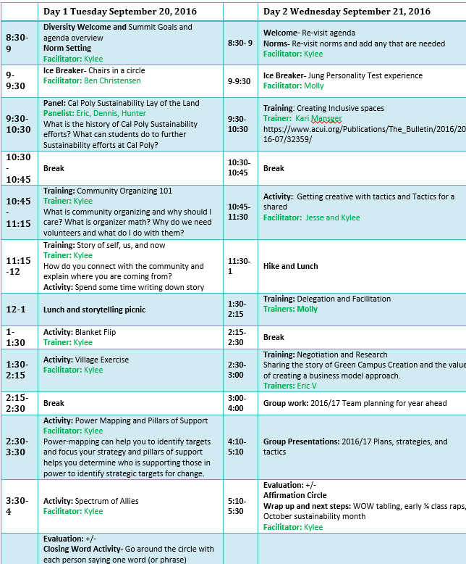
Agenda
Two full days, 8am to 5pm
Agenda mix of presentations, trainings, and activities
Using event as learn by doing example
350.org great resource for training ideas, SOUL train the trainer, campus organizers

Slide 10
Logistics
Free room on campus, easy to book before school starts
Big grocery shopping trip night before and after 1st day
Zero waste event
Room with open floor plan and mobile chairs and tables is ideal

Slide 11
Metrics
Project Cost
Staff Wages- (50 hours)
Materials and supplies- $461.19
Number of people reached by your program
30 student club leaders participated
15 staff and faculty attended presentations
Over 300 students positively affected by the early planning process of their club leaders

Slide 12
Purpose and Outcomes
Redundant/ inefficient efforts
Great ideas: poor implementation
Slow yearly start
Community Building
Leadership Training
Early Momentum

Slide 13
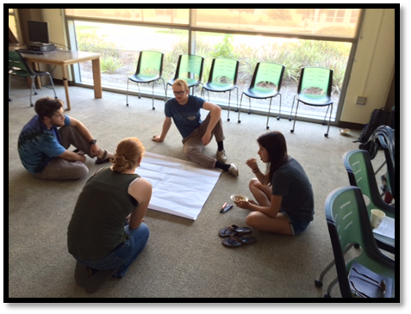
Outcomes
Community Building
-Created space for connections
-Congruous idea creation
-ex. EPC: Meeting and TGIF planning
-Developed network of sustainability leaders for the year

Slide 14
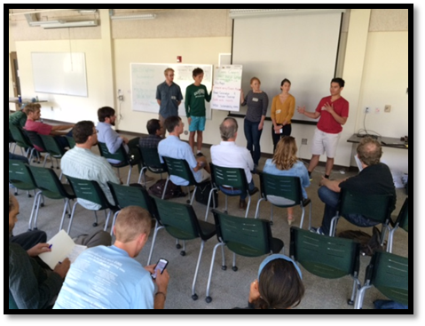
Outcomes
Leadership Training
-Focus on the tangible
-Understanding of the system and
mechanisms of change
-ex. RFC: CSA launch & long-term space
-Identified student leaders

Slide 15
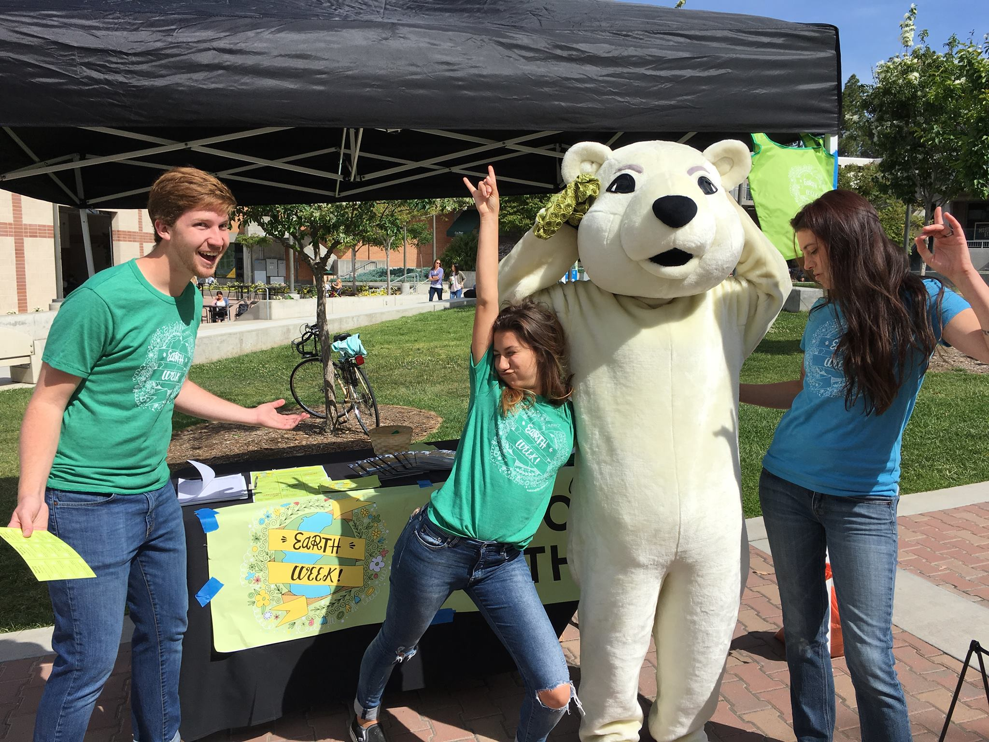
Outcomes
Early Momentum
-Formed plans before school year
-Already planned tangible projects
-Ex. Sustainability Team in EWB
-Connects recruitment and engagement

Slide 16
Lessons Learned
Pluses
Hosting the event immediately before school was a huge success
Students were energized by presenting to campus stakeholders
Students love healthy good food and veggies, even if it means they are making their own salads and sandwiches
Deltas
2 full days is a lot to keep people engaged- this year we will do 1.5 days
Need to broaden our network of clubs

Slide 17
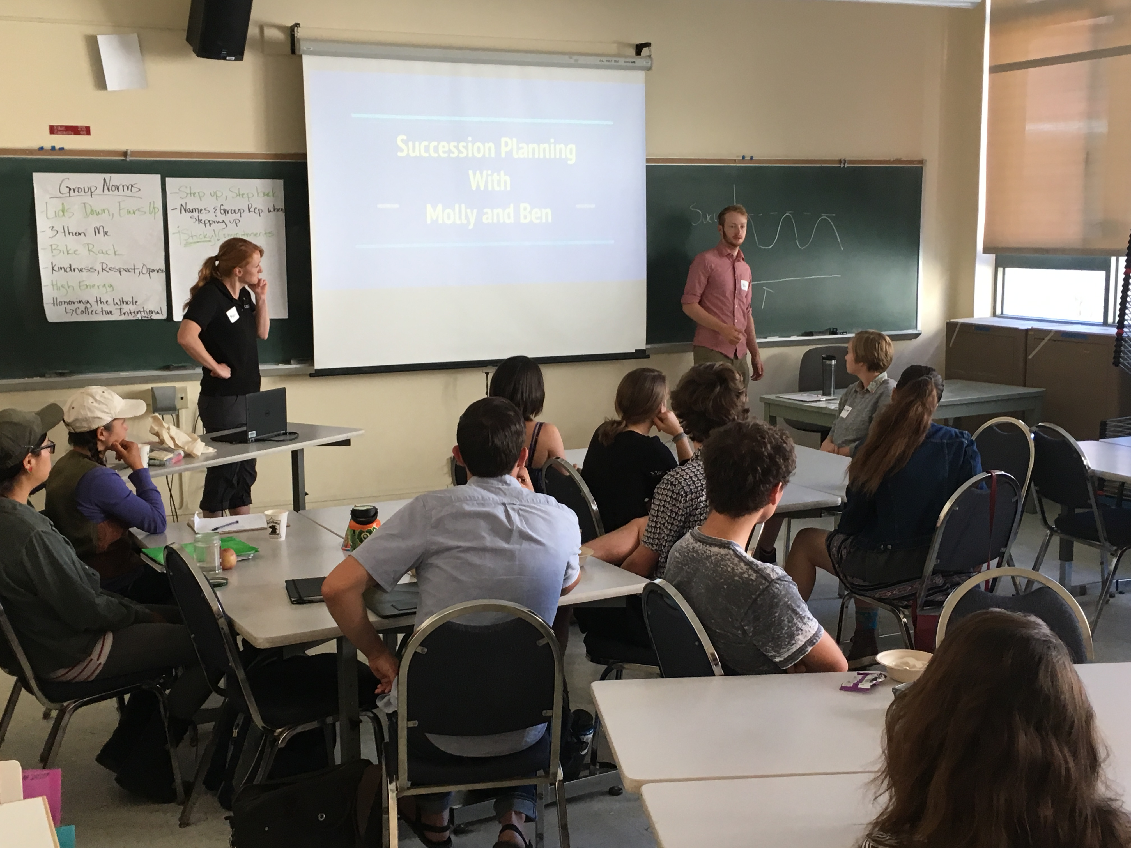
Next Steps
Continual Community Building
-Through Empower Poly
Create follow up training
-Succession planning event in winter
Hosting another larger summit Fall 2017

Slide 18
Sustainability.calpoly.edu

